Slide 1


Leon Catanzariti
June 20, 2024

Slide 2

Outline
Executive Summary
Introduction
Methodology
Results
Conclusion
Appendix

Slide 3
Executive Summary
Summary of methodologies
Data Collection
Data Wrangling
Exploratory Data Analysis with SQL
Exploratory Data Analysis with Data Visualization
Interactive Visual Analytics with Folium
Machine Learning
Logarithmic Regression
Summary of all results

Slide 4
Introduction
Project background and context
The commercial space age is here. Companies are making space travel affordable for everyone. Perhaps the most successful company is SpaceX. SpaceX advertises Falcon 9 rocket launches on its website with a cost of 62 million dollars, while other providers cost upwards of 165 million dollars. Much of the savings is because SpaceX can reuse the first stage. Therefore, if we can determine if the first stage will land, we can determine the cost of a launch.
We will train a machine learning model and use public information to predict if SpaceX can reuse the first stage.

Slide 5

Section 1

Slide 6
Methodology
Executive Summary
Data collection methodology:
Past launch data was retrieved from two places...
SpaceX REST API (https://api.spacexdata.com/v4/rockets)
WebScraping of Wikipedia pages (https://en.Wikipedia.org/wiki/List_of_Falcon/_9/_and_Falcon_Heavy_launches)
Data wrangling
Data was received via JSON formatted files. We converted this data into a Pandas dataframe using json_normalize function. Null values were replaced by mean values for Payload Mass.
Perform exploratory data analysis (EDA) using visualization and SQL
Perform interactive visual analytics using Folium and Plotly Dash
Perform predictive analysis using classification models
Data was normalized and divided into Train and Test data sets. It was then evaluated by 4 different classification models.

Slide 7
Data Collection
Historical launch data was retrieved from two places...
SpaceX REST API (https://api.spacexdata.com/v4/launches/past)
WebScraping of Wikipedia (https://en.Wikipedia.org/wiki/List_of_Falcon/_9/_and_Falcon_Heavy_launches)

Slide 8
Data Collection – SpaceX API
GitHub URL : https://github.com/leoncat1/LCat-GITRepository/blob/main/jupyter-labs-spacex-data-collection-api.ipynb
requests.get(https://api.spacexdata.com/v4/launches/past)
requests.get("https://api.spacexdata.com/v4/rockets)
requests.get(https://api.spacexdata.com/v4/launchpads/)
requests.get(https://api.spacexdata.com/v4/payloads/)
requests.get(https://api.spacexdata.com/v4/cores/)

Slide 9
Data Collection - Scraping
requests.get(https://en.wikipedia.org/w/index.php?title=List_of_Falcon_9_and_Falcon_Heavy_launches&oldid=1027686922)
GitHub URL : https://github.com/leoncat1/LCat-GITRepository/blob/main/jupyter-labs-webscraping.ipynb
Use BeautifulSoup to read HTML
Extract Column Names using find_all
Read through result set, populating extracted data into Dictionary
Load Dictionary into Pandas Dataframe

Slide 10
Data Wrangling
A new column called “Class” was created in the dataframe to capture a binary value for the Landing Outcome class (1 = Successful Landing, 0 = Unsuccessful Landing)
Values in the “landing_outcome” column are used to populate “Class”
Successful landing_outcome values
True ASDS
True RTLS
True Ocean
Unsuccessful landing_outcome values
None None
False ASDS
False Ocean
None ASDS
False RTLS
GitHub URL : https://github.com/leoncat1/LCat-GITRepository/blob/main/jupyter-labs-webscraping.ipynb

Slide 11
EDA with Data Visualization
GitHub URL : https://github.com/leoncat1/LCat-GITRepository/blob/main/jupyter-labs-eda-data-visualization.ipynb
Visualizations
Scatter plot to see the relationship between Flight Number and Launch Site.
Scatter plot to see the relationship between Payload Mass and Launch Site.
Bar chart to compare the Success Rate of various Orbits.
Scatter plot to see the relationship between Flight Number and Orbit.
Scatter plot to see the relationship between Payload Mass and Orbit.
Line Plot to see the Success Rate of launches by Year.

Slide 12
EDA with SQL
SQL Queries
Distinct Launch Sites
Launch Sites Beginning with CCA
Sum of Payload Mass for NASA (CRS) Customer
Average Payload Mass carried by Booster Version F9 v1.1
Date of first successful landing outcome
Boosters with Success in Drone Ship and Payload Mass between 4K/6K
Count of successful/unsuccessful outcomes
Boosters that carried the Maximum Payload Mass
Failures in Drone Ship in 2015
Ranked count of Landing Outcomes between 2010-06-04 and 2017-03-20
GitHub URL : https://github.com/leoncat1/LCat-GITRepository/blob/main/jupyter-labs-eda-sql-coursera_sqllite.ipynb

Slide 13
Build an Interactive Map with Folium
GitHub URL : https://github.com/leoncat1/LCat-GITRepository/blob/main/lab_jupyter_launch_site_location.ipynb
Markers, marker clusters, circles and distance lines were created using Folium.
Launch sites were identified on a map, which could be used to drill down to specific launch results (marker clusters).
Distance Lines were used to show the distance between launch sites and landmark objects. The objects included nearest city, coastline, highway and railway.

Slide 14
Build a Dashboard with Plotly Dash
We built a dashboard with Plotly Dash with the following features...
A Pie Chart containing percentage of Success/Failure Launches featuring a dropdown box to select various Launch Sites.
When selecting ALL, the percentage of Overall Successes for each Launch Site is displayed.
When selecting a specific Launch Site, the pie chart represents the percentage of Successes for that Launch Site.
A Scatter Plot with a Range Slider for the user to select a range of Payload Mass.
When the range is selected, a plot of each success and failure is shown for Launches having Payload Mass falling with the range.
GitHub URL : https://github.com/leoncat1/LCat-GITRepository/blob/main/spacex_dash_app.py

Slide 15
Predictive Analysis (Classification)
We standardized and split the data into Train and Test data sets.
We used Logistic Regression, Support Vector Machine, Decision Tree and K-Nearest Neighbors methods to determine the best model.
GitHub URL : https://github.com/leoncat1/LCat-GITRepository/blob/main/SpaceX_Machine%20Learning%20Prediction_Part_5.ipynb

Slide 16
Results
Exploratory data analysis results
There are 4 Launch Sites in the SpaceX data set.
Total Payload Mass for all launches is 45,596 kg.
The average mass for F9 v1.1 launches is 2,928.4 kg.
The first successful landing occurred on 12/22/2015.
There were 4 different boosters with landed successful drones with payload between 4,000 and 6,000 kg.
Successful missions out-paced unsuccessful missions by 100 to 1.
There were 2 boosters that failed to land their drone in 2015.

Slide 17

Section 2

Slide 18
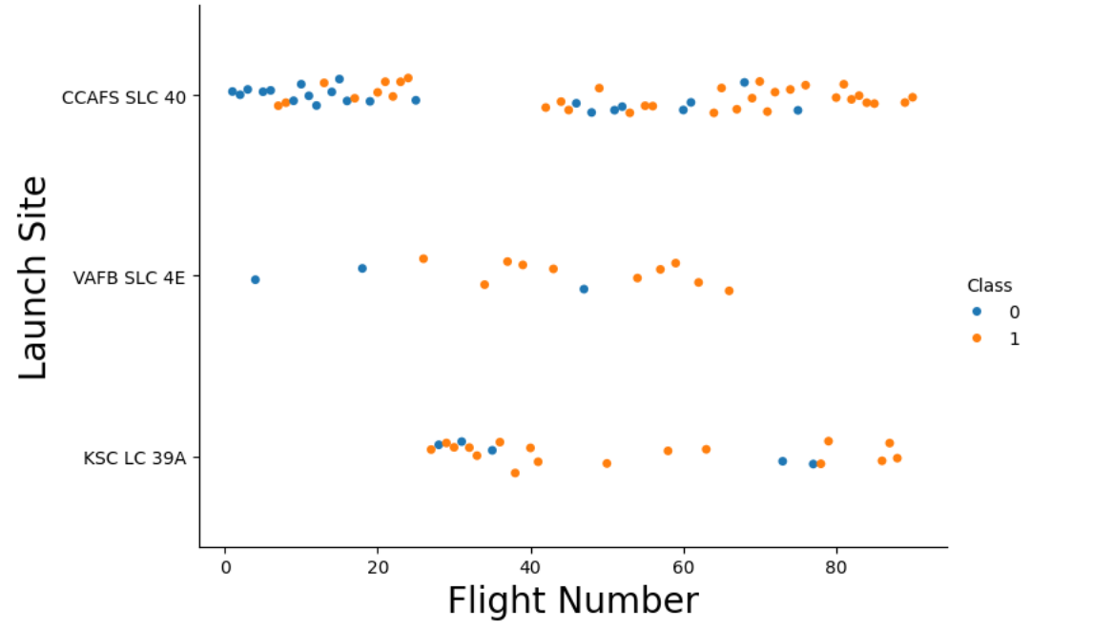
Flight Number vs. Launch Site
We are able to determine that as the number of flights at each site increases, those flights tend to be more successful

Slide 19
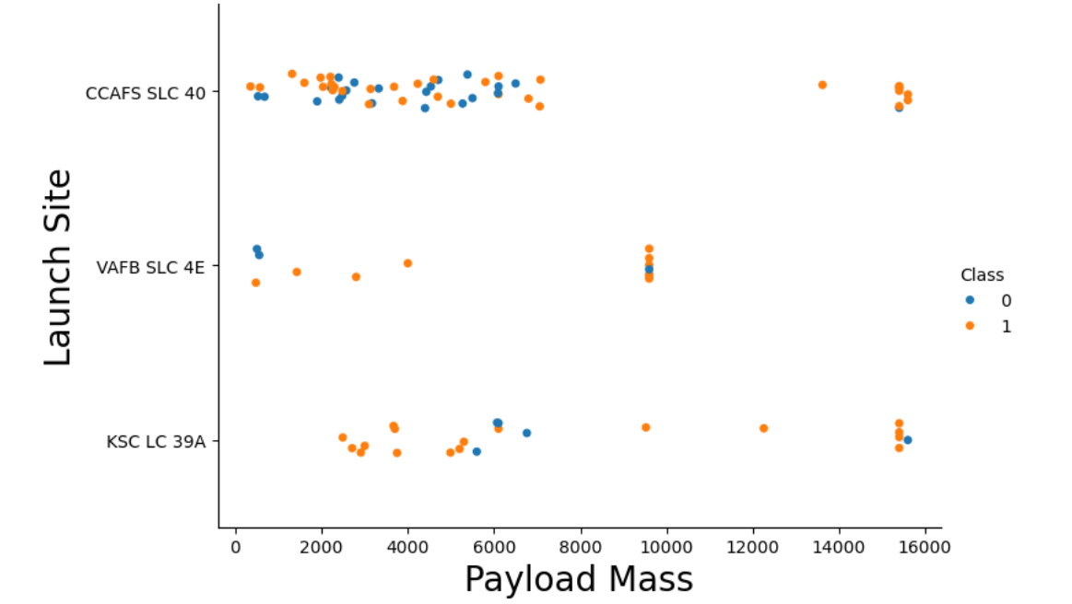
Payload vs. Launch Site
We see a slight improvement of Launch Site success when the Payload Mass is increased

Slide 20
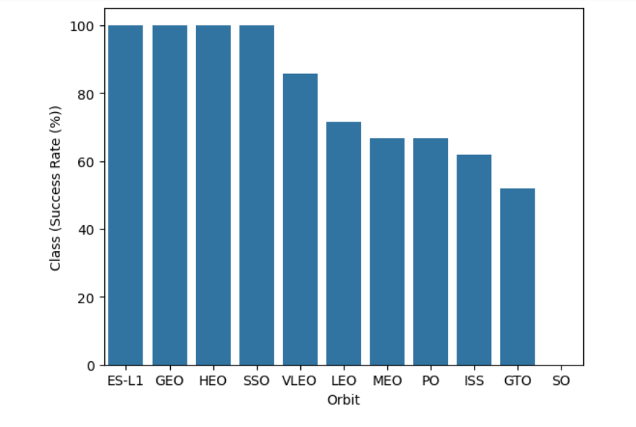
Success Rate vs. Orbit Type
Best Orbits
ES-L1, GEO, HEO and SSO show 100% success rate.
Worst Orbits :
GTO has the lowest success rate (~50%).

Slide 21
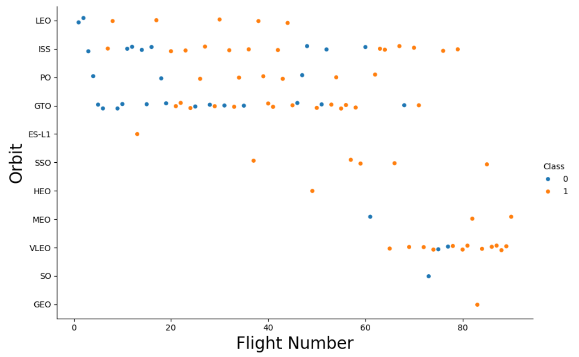
Flight Number vs. Orbit Type
We observe that the Launch Success Rate improves over time for each Orbit Type.

Slide 22
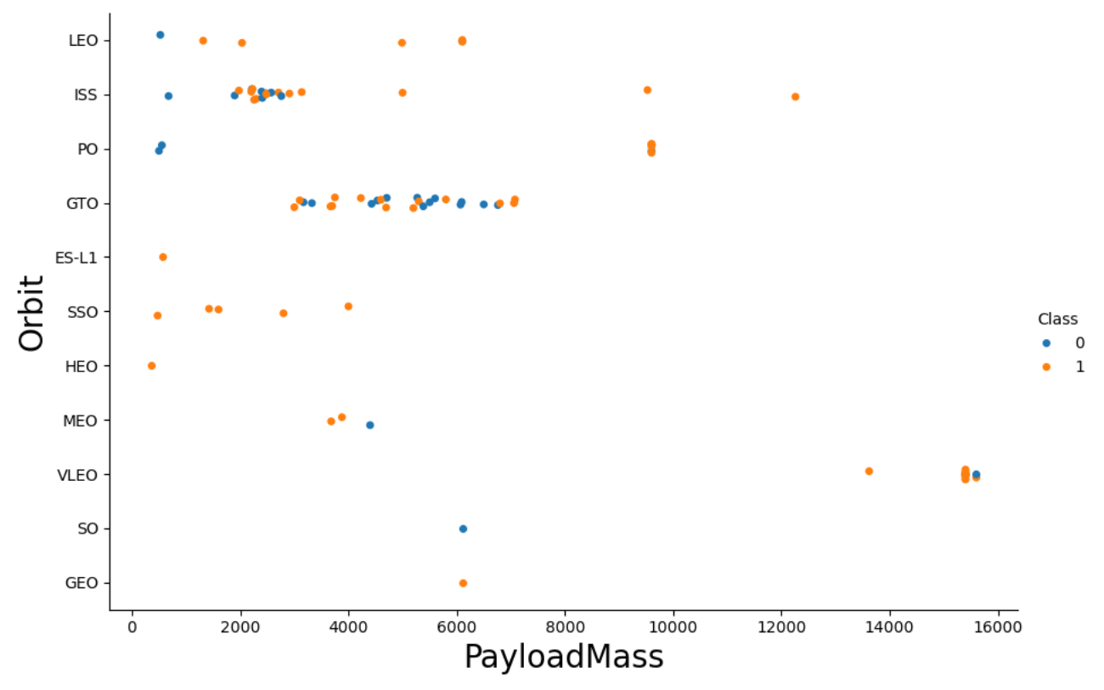
Payload vs. Orbit Type
We notice that a heavier Payload Mass generally results in a higher Success Rate, although this is not necessarily the case for GTO.
Smaller sample sizes for other Orbits should be looked into further.

Slide 23
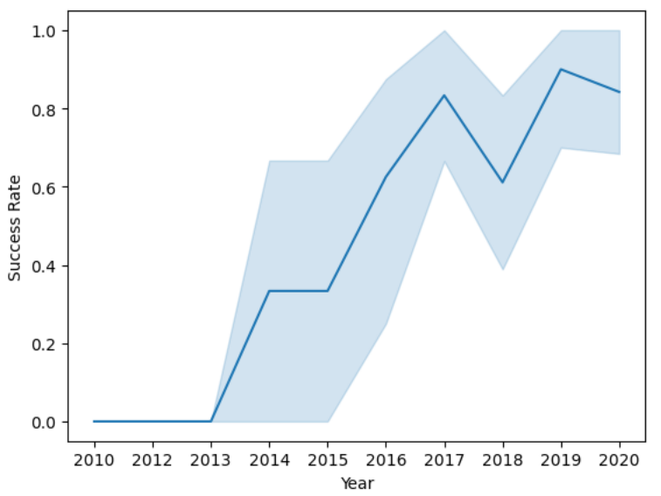
Launch Success Yearly Trend
Clearly, we can see that Launch Success Rates have increased over time from 2013 to 2020.

Slide 24
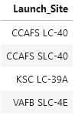
All Launch Site Names
We obtained a list of Launch Site names which were present in our dataset.

Slide 25
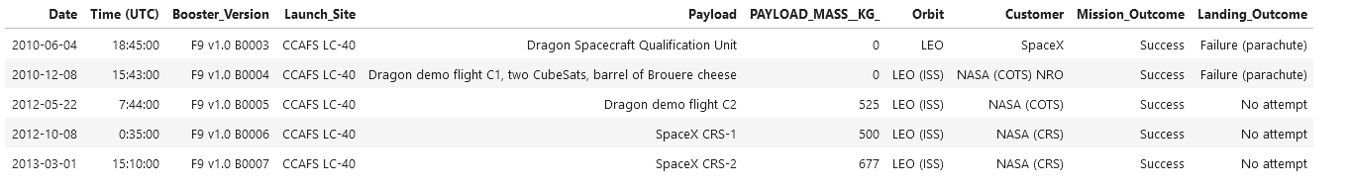
Launch Site Names Begin with 'CCA'
We retrieved 5 records from Launch Sites beginning with ‘CCA’...

Slide 26
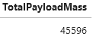
Total Payload Mass
We calculated the Total Payload Mass for NASA (Customer)...

Slide 27
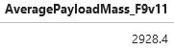
Average Payload Mass by F9 v1.1
We obtained the Average Payload Mass for F9 v1.1 Boosters...

Slide 28
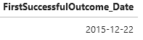
First Successful Ground Landing Date
We retrieved the date of the first successful landing outcome...

Slide 29
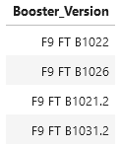
Successful Drone Ship Landing with Payload between 4000 and 6000
We determined the boosters who had success in Drone Ship and a Payload Mass greater than 4000, but lower than 6000...

Slide 30
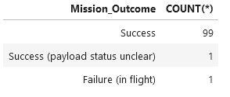
Total Number of Successful and Failure Mission Outcomes
In counting the Mission Outcome, we can see that almost all missions have been successful.

Slide 31
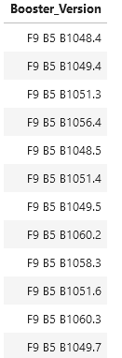
Boosters Carried Maximum Payload
Using a subquery to determine the maximum Payload Mass, we determined that the following Booster Versions used the maximum Payload Mass...

Slide 32
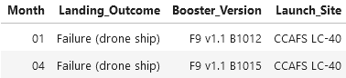
2015 Launch Records
We can see that the following 2 launches had failed landings via the drone ship...

Slide 33
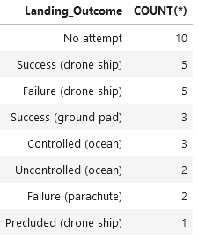
Rank Landing Outcomes Between 2010-06-04 and 2017-03-20
We ranked the counts of landing outcomes between the date 2010-06-04 and 2017-03-20, in descending order...

Slide 34

Section 3

Slide 35
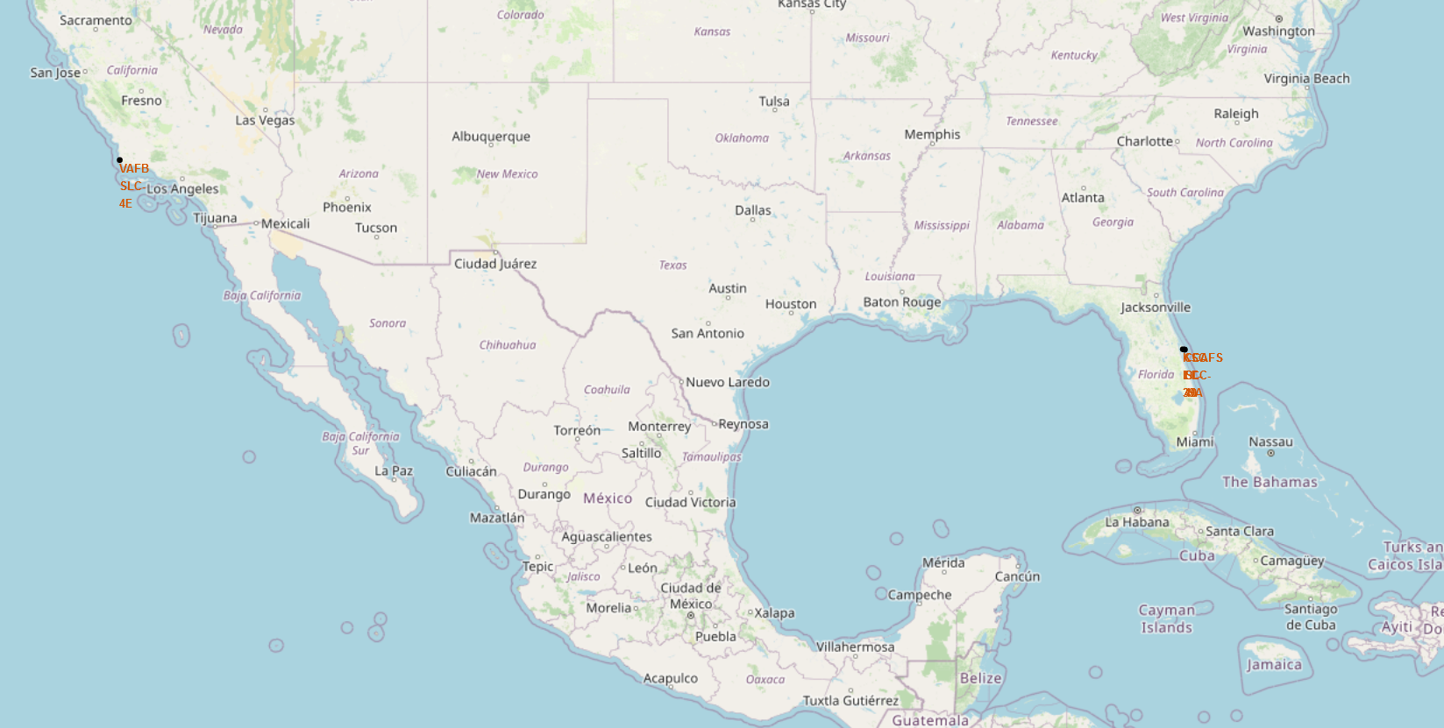
All Launch Sites Global Map Markers
SpaceX Launch Sites are located in California and Florida, USA.

Slide 36
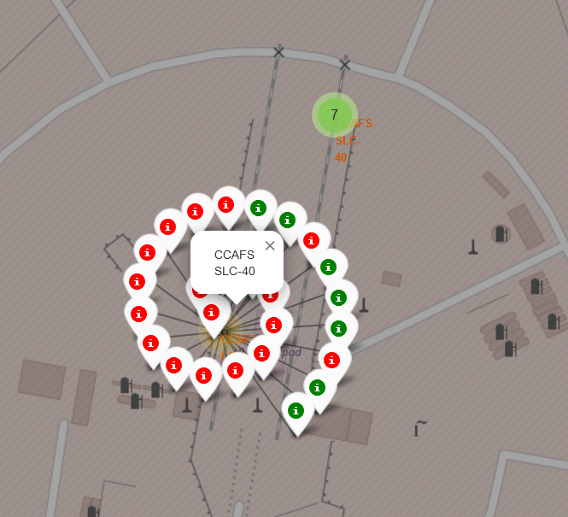
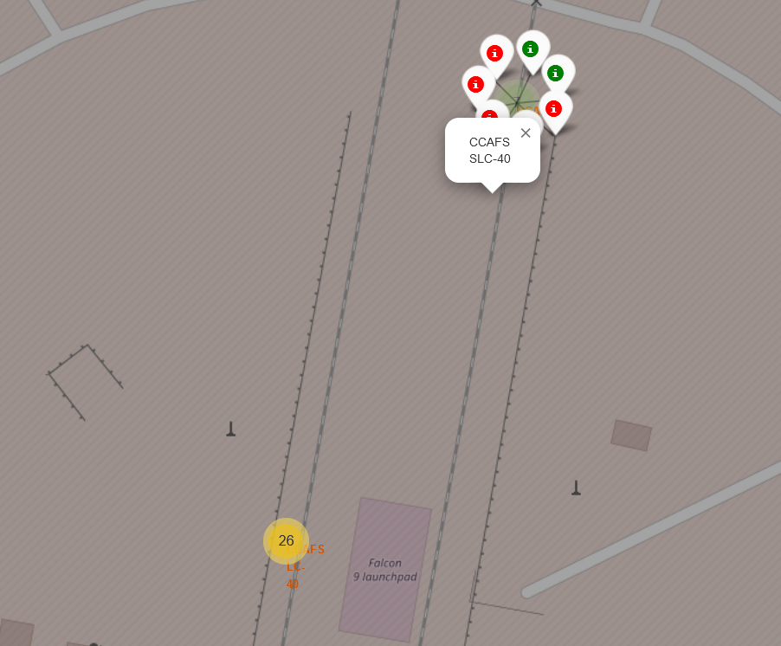
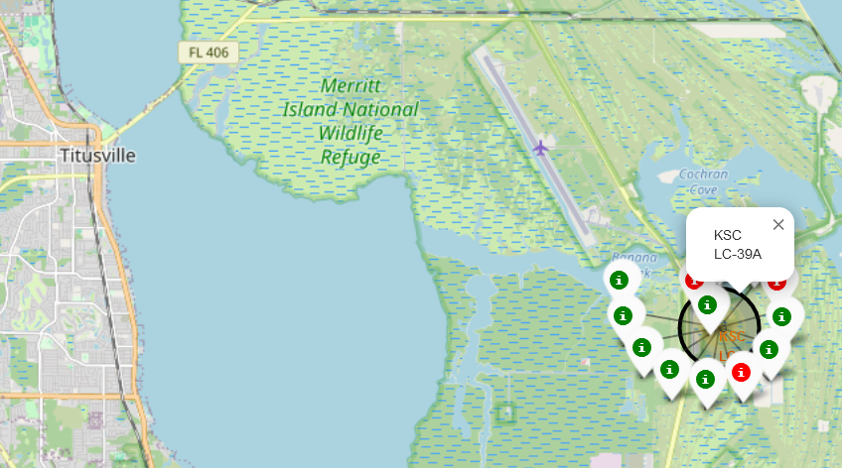
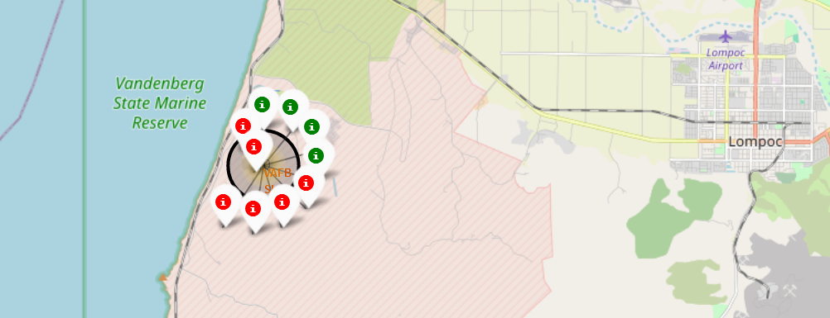
Launch Sites in Florida and California
Florida Launch Sites :
California Launch Site :

Slide 37
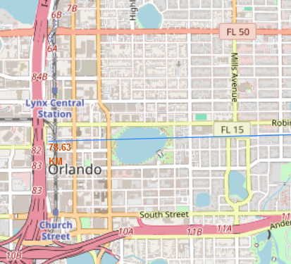
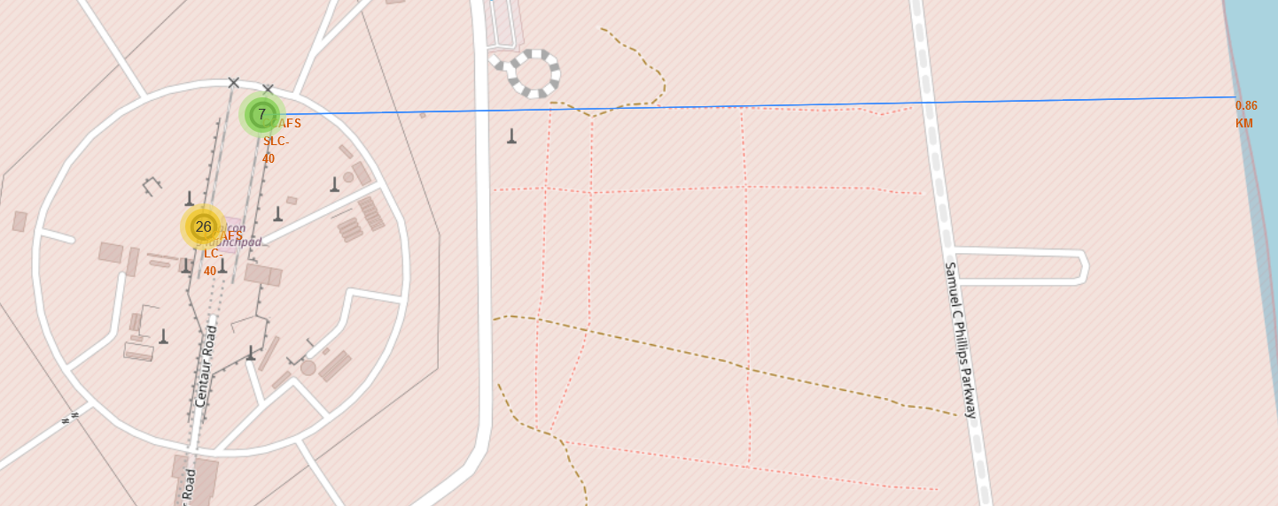
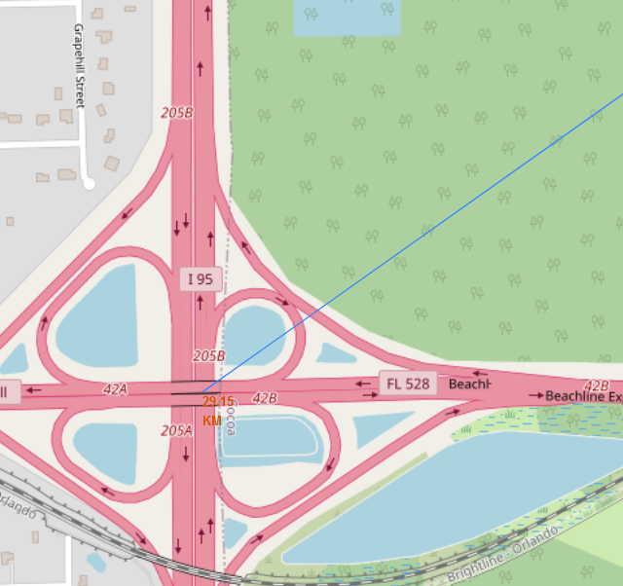
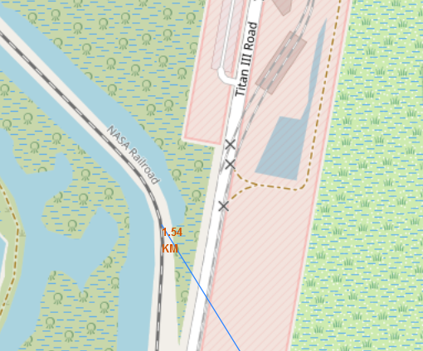
Launch Site Distances from Landmarks
Nearest Coastline
Nearest City
Nearest Highway
Nearest Railway

Slide 38

Section 4

Slide 39
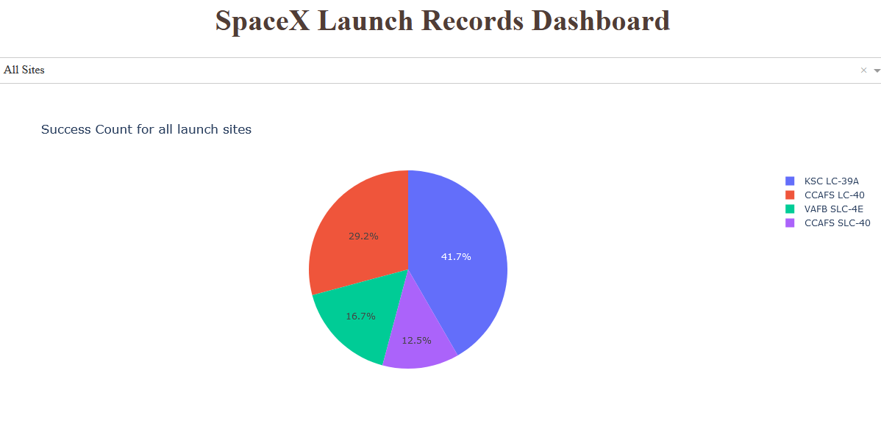
Success Count for All Launch Sites
KSC LC-39A has the most successful launches of any site, accounting for 41.7% of all successful launches
CCAFS SLC-40 has the least successful launches at 12.5% of all successful launches.

Slide 40
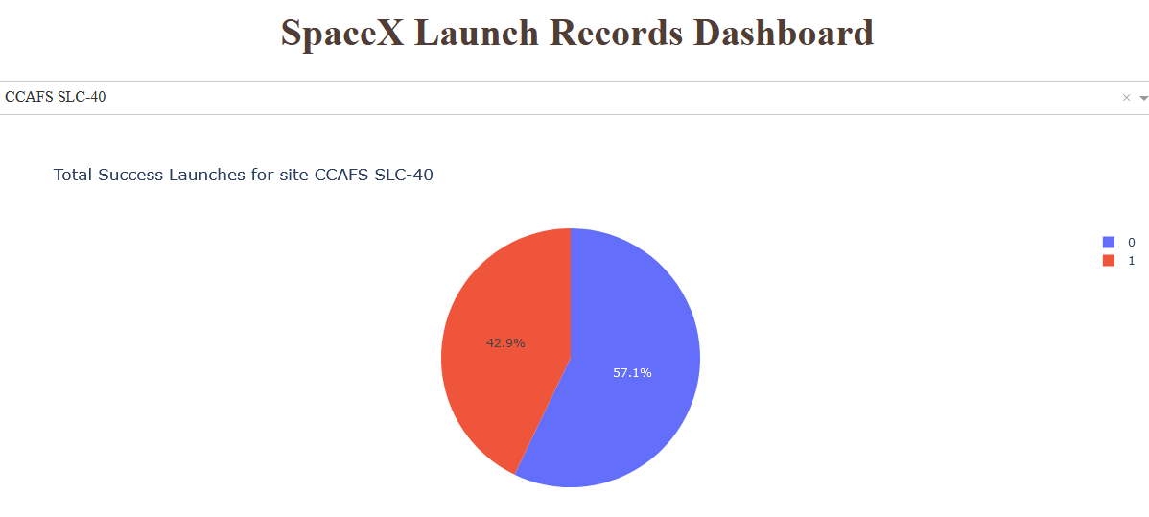
Launch Site with Highest Pct of Success
CCAFS SLC-40 has the highest success rate for all launch sites, at 42.9%

Slide 41
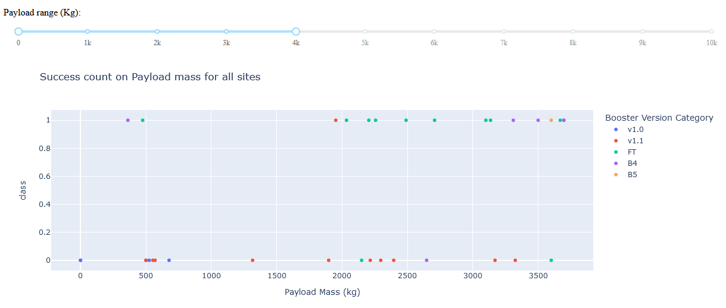
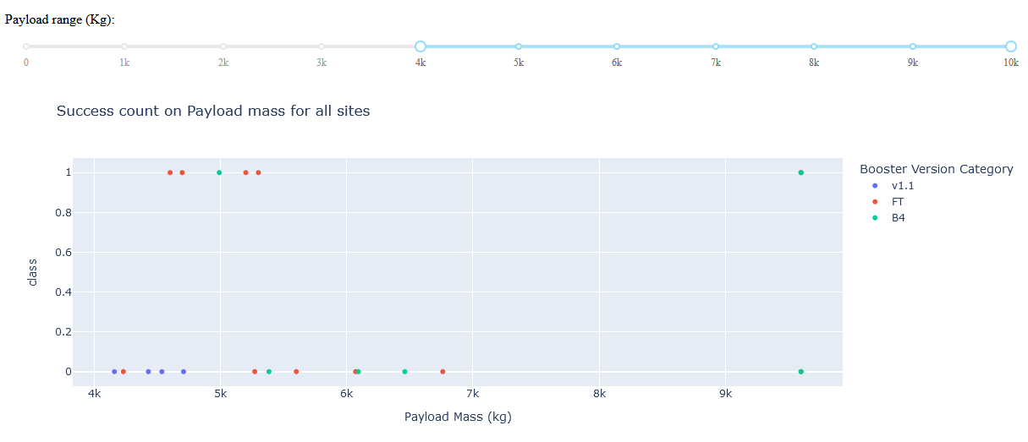
Successful Launches for Payload Ranges
Launches with lower payloads (<=4K kg) seem to have a higher rate of success than launches with higher payloads (>4K kg)

Slide 42

Section 5

Slide 43
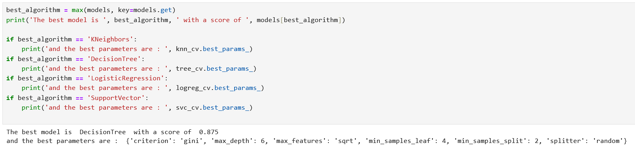
Classification Accuracy
The best model was the Decision Tree Model.
The best parameters were :
Criterion = ‘gini’
Max Depth = 6
Max Features = ‘sqrt’
Min Samples Leaf = 4
Min Samples Split = 2
Splitter = ‘Random’

Slide 44
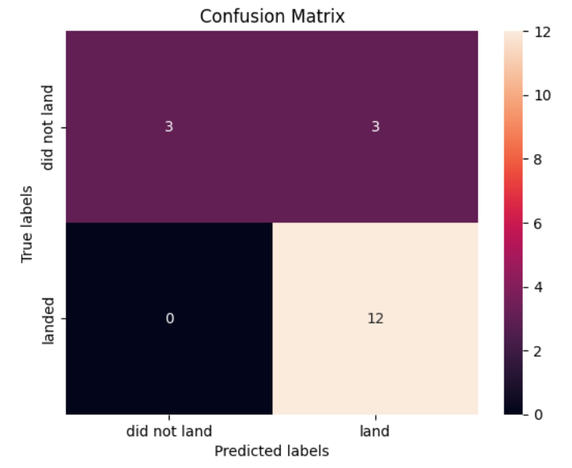
Confusion Matrix
The Confusion Matrix shows that our model correctly predicted 12 landings to be successful. However, we were high on false positives, as 3 of our 6 predicted successes were actually unsuccessful.

Slide 45
Conclusions
We can conclude…
As more launches happen, the overall success rate improves for every Landing Site.
Orbits ES-L1, GEO, HEO and SSO had the best success rates, while Orbit GTO had the lowest.
The most popular landing outcome was “no attempt” between 2010-06-04 and 2017-03-20.
The best predictive model was Decision Tree, with a score of .875

Slide 46


